Slide 1
Renewable Energy Reserves of Taiwan
Falin Chen
National Taiwan University

Slide 2
Methodologies for Assessing National RE Resources
 | A.『Top Down』Methodology | B.『Bottom Up』Methodology
Characteristics | A method optimistic as far as possible | A method close to the actual situation as far as possible
Applicable Opportunity | When assessing the reserves of renewable energy in an overall nation or large region | When industry considers to develop renewable energy in a specific area
Qualitative Difference | 「Available Reserves」: energy reserve per unit area multiplied by available area of land or sea | 「Developable Reserves」: In addition to the energy density and land size, also need to consider economic factors (such as high cost), environmental factors (such as influences of environment or ecology), decree factors (such as prices of oil and electricity, barriers to obtain development permission) and other barriers caused by practical factors
Quantitative Difference | Regarding per capita and per unit area, the developable reserve is often much lower than the available reserve

Slide 3
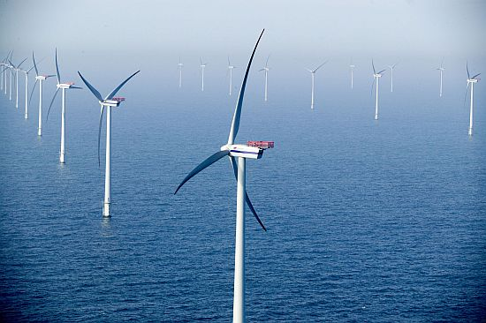
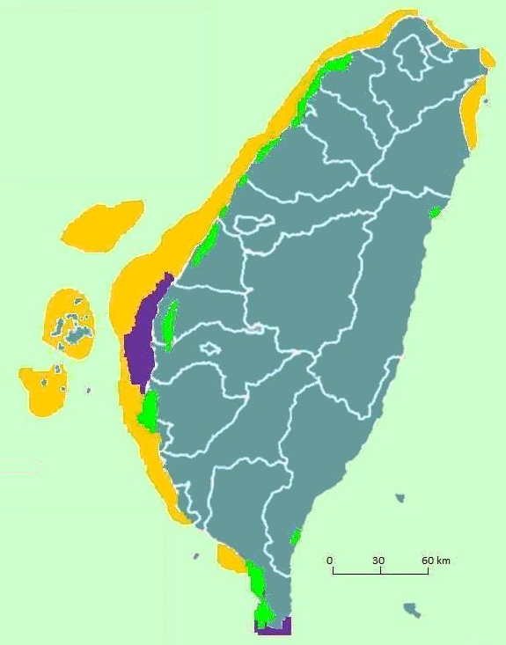
1. Wind Power Reserve
 | Offshore wind farm
Area | 4233.6 km²
Installation Capacity | 36,750 2MW wind turbines Total 73.5 GW
Electricity Generation | 28.9 kWh/p/d
Energy Density | 57.4 GWh/km²/y
Environmental protection area
 | Land-based wind farm
Area | 69.2 km²
Installation Capacity | 600 2MW wind turbines
 | Total 1.2 GW
Electricity Generation | 0.3 kWh/p/d
Energy Density | 36.1 GWh/km²/y

Slide 4
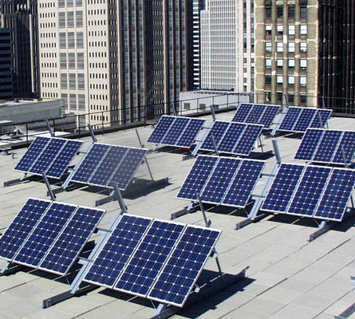
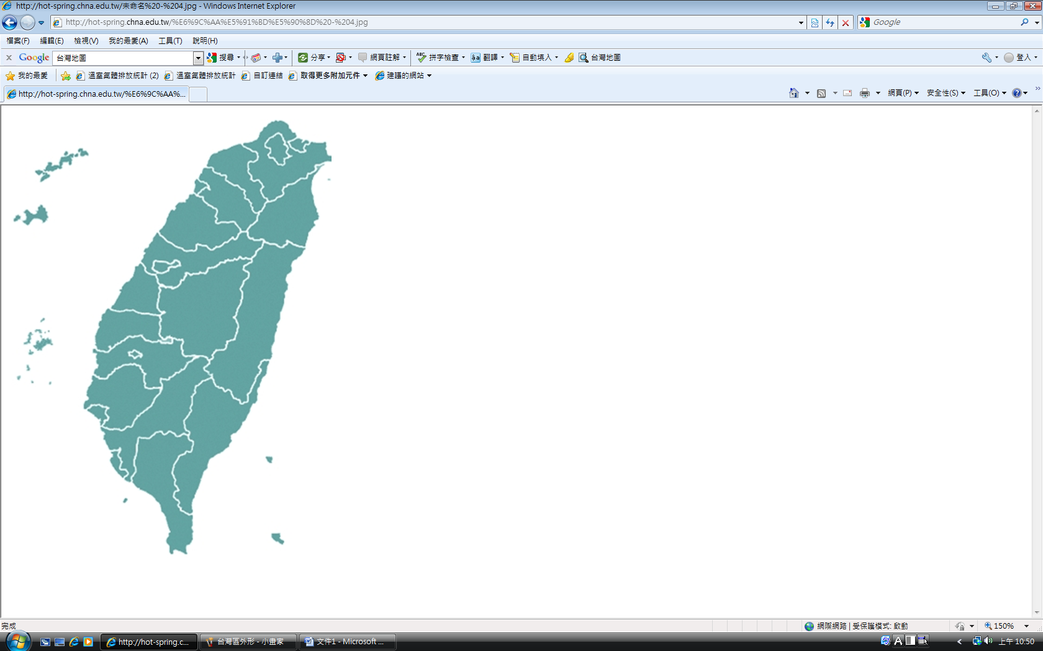
2. Solar Power Reserve
PV Farm Installed Site |  | Area (km²) | Solar Energy Reserves (kWh/p/d)
Public Land 1% | Highway # 1 (5 m two sides) | 6.3 | 4.85
 | Highway # 3 (5 m two sides)
 | High speed roads (5 m two sides)
 | Taiwan High Speed Rail (3 m two sides) | 6.09
 | Taiwan Rail Road (3 m two sides)
 | Other Public Lands | 347.61
Industrial Zone ( 75% is old) |  | 280 | 3.76
Rooftop and Farm |  | 500 | 6.73
Land reclamation (20 m depth, 50% area) |  | 582.2 | 7.74
Solar thermal energy on rooftop |  | 17.8 | 1.19
Total |  | 1740.0 | 24.27
Solar Energy Density |  | 117.13 GWh/km²/y

Slide 5
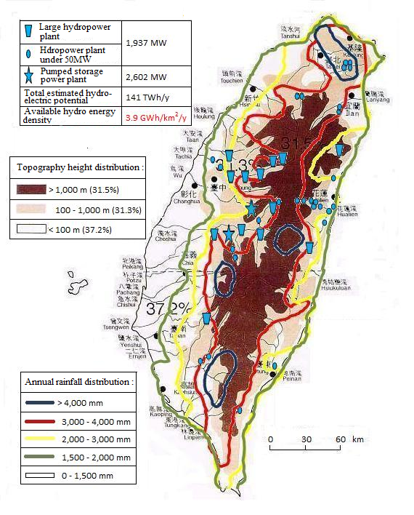
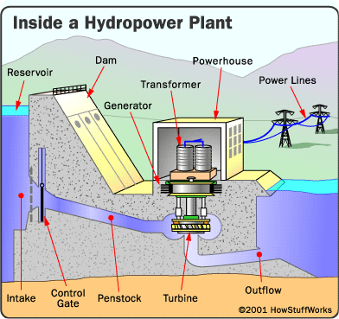
3. Hydro Power Reserve
Large hydropower plant | 1,937 MW
Hydropower plant under 50 MW
Pumped storage power plant | 2,602 MW
Total estimated hydro- electric potential | 141 TWh/y
Available hydro energy density | 3.9 GWh/km²/y
Topography height distribution：
> 1,000 m (31.5%)
100 - 1,000 m (31.3%)
< 100 m (37.2%)
Schematic diagram of hydraulic energy use
(http://www.greennews.com/images/hydro2.gif)
Annual rainfall distribution：
> 4,000 mm
3,000 - 4,000 mm
2,000 - 3,000 mm
1,500 - 2,000 mm
0 - 1,500 mm
References : [14] [16] [17] [18] [19] [20]

Slide 6
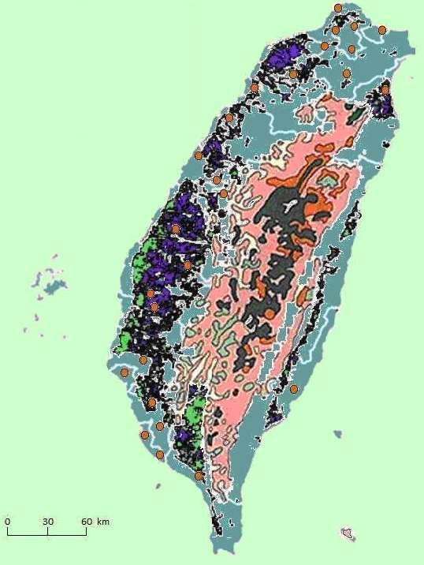
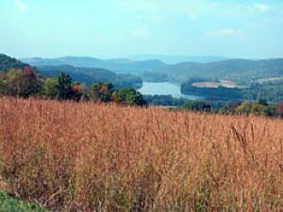
4. Biomass Power Reserve
 | Garbage incinerators | 26 plants (21,900 ton/day)
 | Agricultural waste planting energy crop | Potential : 0.90 kWh/p/d
 | Common agricultural land | Agriculture-Forest Waste:6,340,000 ton/year
 | Coniferous forest (1)
 | Coniferous forest (2)
 | Broad-leaved forest
 | Grassland

Slide 7
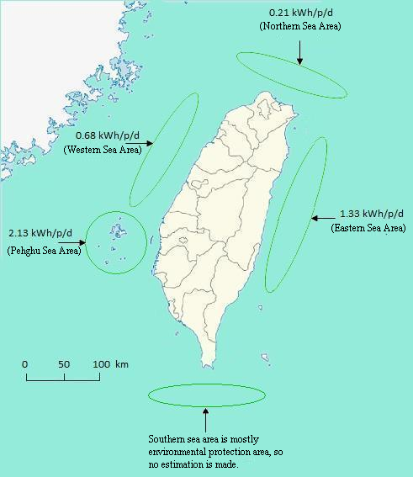
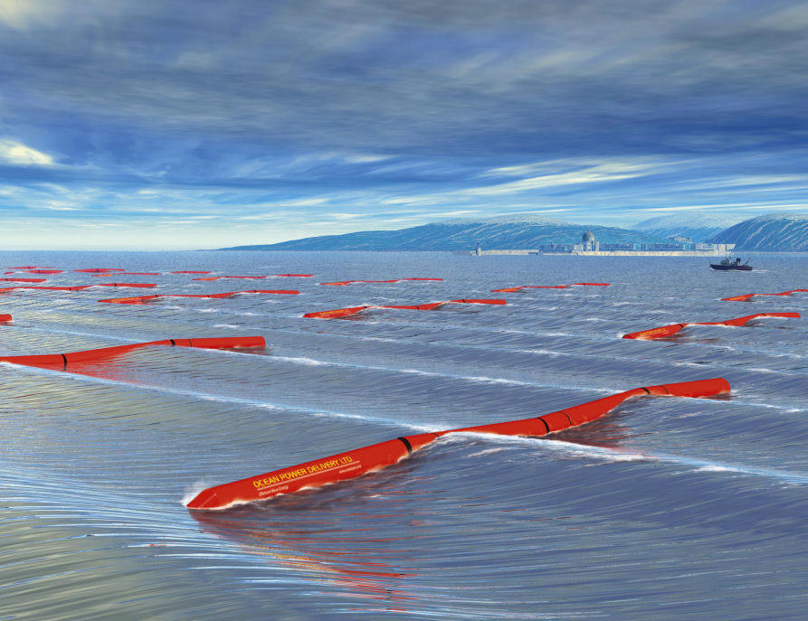
5. Wave Energy Reserve
 | Power | Power Generation | Coast Length | Energy Density
 | (GW) | kWh/p/d | (km) | (GWh/km/y)
Eastern Sea Area | 2.50 | 1.33 | 380 | 29.38
Western Sea Area | 1.28 | 0.68 | 460 | 12.41
Northern Sea Area | 0.40 | 0.21 | 85 | 20.74
Penghu Sea Area | 4.02 | 2.13 | 320 | 55.88
Total | 8.20 | 4.35 | 1,245 | 29.33

Slide 8
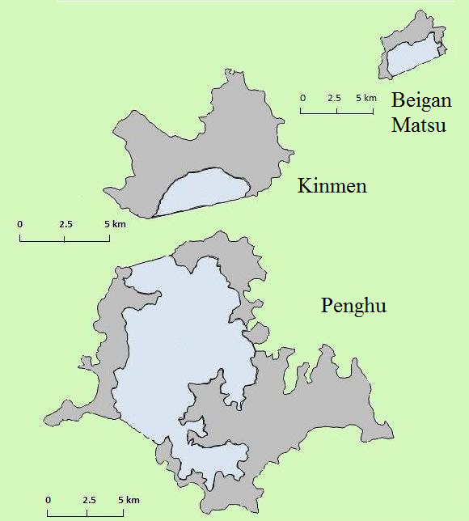

6. Tidal Energy Reserve
 | Power | Power Generation | Block Area | Energy Density
 | (GW) | kWh/p/d | (km²) | (GWh/km²/y)
Penghu Bay | 0.062 | 0.06 | 70 | 7.2
Liaolo Bay Kinmen | 0.131 | 0.12 | 3.8 | 265
Beigan Matsu | 0.043 | 0.04 | 4.3 | 78.1
Total | 0.236 | 0.22 | 78.1 | 23.6

Slide 9
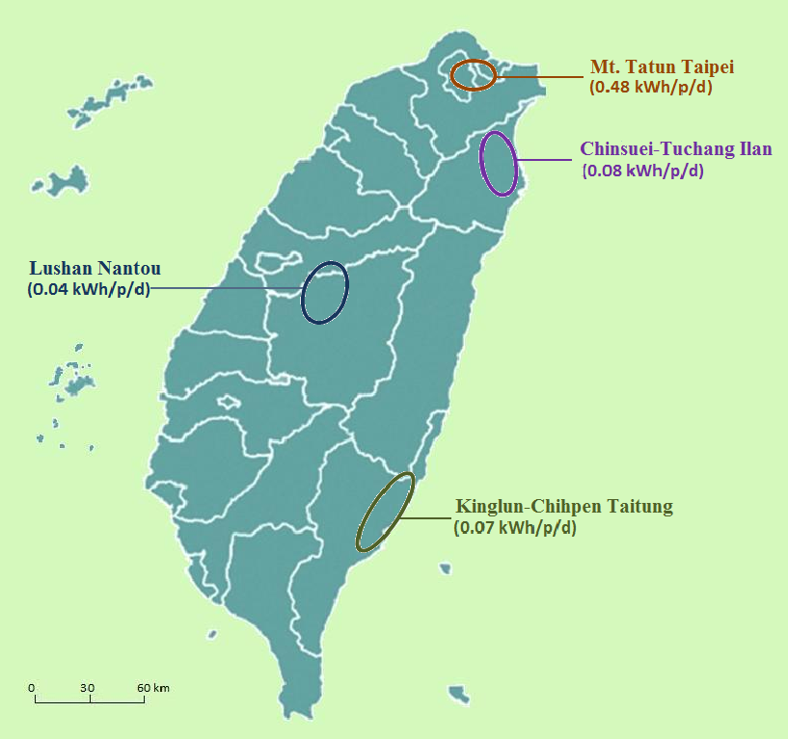
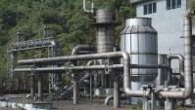
7. Geothermal Power Reserve
Geothermal Sites | Temperature Range (℃) | Installation Potential (MWe) | Power Potential (kWh/d/p)
Chinsuei, Ilan | 180-220 | 61 | 0.06
Tuchang, Ilan | 160-180 | 25 | 0.02
Lushan, Nantou | 150-210 | 41 | 0.04
Chihpen, Taitung | 140-200 | 25 | 0.02
Kinglun, Taitung | 140-180 | 48 | 0.05
Mt. Tatun, Taipei | 200-290 | 514 | 0.48
Total Potential |  | 714 | 0.67

Slide 10
Renewable Energy Reserves of Taiwan
Renewable and Sustainable Energy Reviews, 14, 2511-2528, 2010.
 | Solar | Wind | Biomass | Marine | Geo- Thermal | Hydro | Total
Reserve | 24.27 | 29.90 | 1.82 | 4.58 | 0.67 | 16.79 | 78.03
Percentage | 31.3 % | 38.3 % | 2.3 % | 5.9 % | 0.8 % | 21.5 % | 100%

Slide 11
Global Renewable Energy Reserves
Item | Country (or Region) | Renewable Energy Reserves (kWh/d/p) |  | Description
1 | Denmark [24] | 81.2 |  | Population: 5.4 million
2 | The U.K. | A.[25] | 34.5 | Population: 5.4 million
 |  |  |  | East Region, England
 |  | B.[14] | 175.5 | Population: 60.9 million
 |  |  |  | The U.K.
3 | Germany [26,27] | 18.9 |  | Population: 82 million
 |  |  |  | Excluding ocean energy
4 | China [24] | 39.43 |  | Population: 1321.29 million
5 | India [28] | 1.22 |  | Population: 1,200 million
 |  |  |  | Potential of total installation capacity: 152,000 MW
6 | California [29] | 6.1 |  | Population: 38 million
 |  |  |  | Potential of total installation capacity: 24,153 MW (including 9,153 of pump storage)
7 | Massachusetts [30] |  |  | Population: 6.5 million
 |  | 61.9 (theoretical value) |  | Installation potential:
 |  | 13.16 (technically feasible) |  | 41,900 MW(theoretical value)
 |  |  |  | 8,700-12,900 MW(technically feasible)
8 | Florida [31] | 9.89 |  | Population: 14.6 million
 |  |  |  | Installation potential: 52,700 GW (Consider the technical feasibility of 2020’s target)
9 | Arizona [32] | 11 |  | Population: 3.6 million
 |  |  |  | Consider the technical feasibility of 2025’s target
10 | World [33] | 27.5 |  | Population: 6 billion
 |  |  |  | Global reserves: 30,200 TWh

Slide 12
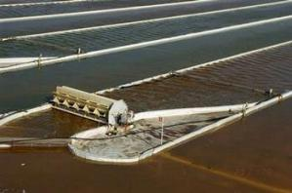
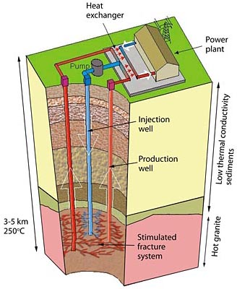
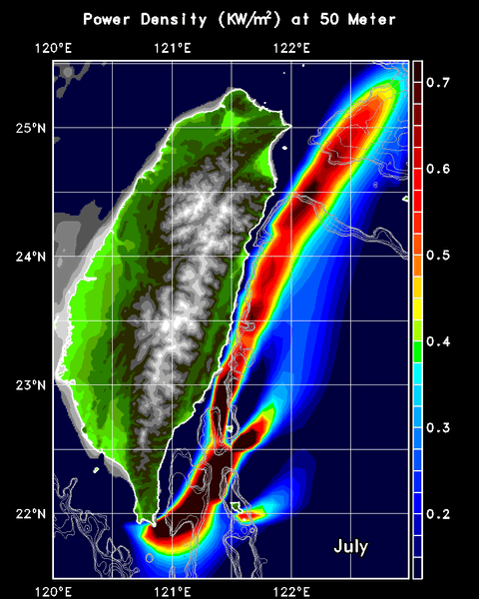
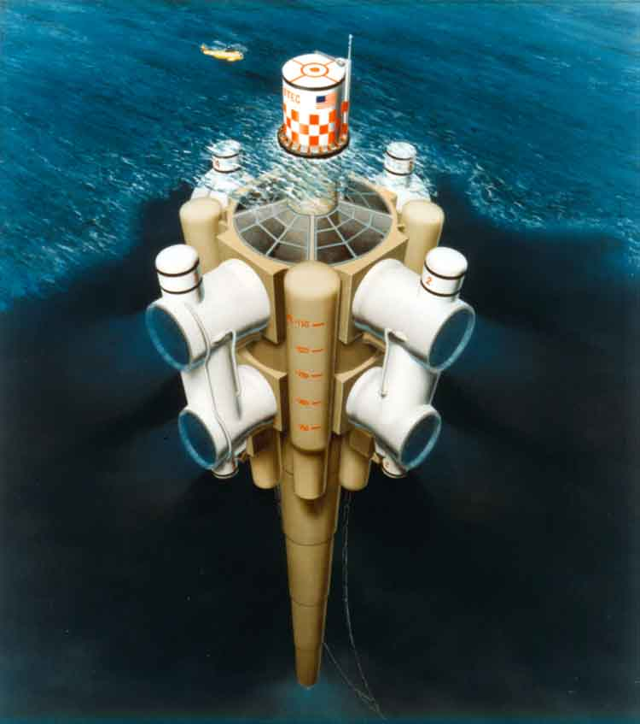
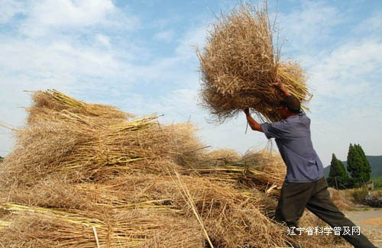
Renewables in The Future
 | Second-Generation Biomass | Deep Geothermal | Kuroshio | OTEC
Reserved Power | 20.17 | 15.48 | 10.96 | 8.32
Total | 54.93 (unit: kWh/d/p)

Slide 13
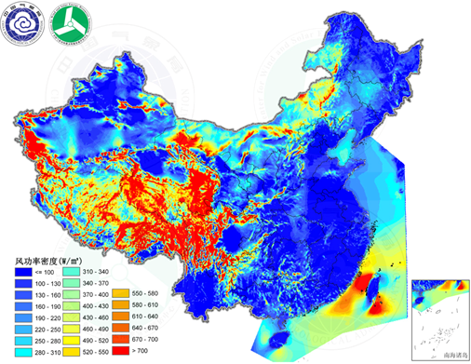
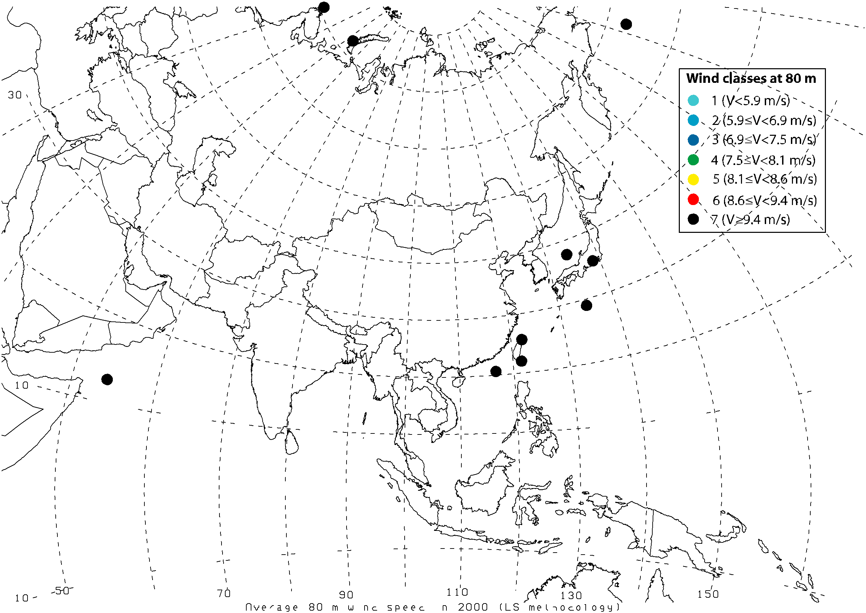
There are evidences showing Taiwan has abundant wind energy reserves
http://www.nap.edu/catalog/12987.html (2010)
Archer & Jacobson, J. Geophysical Research, 110, D12220, 2005

Slide 14
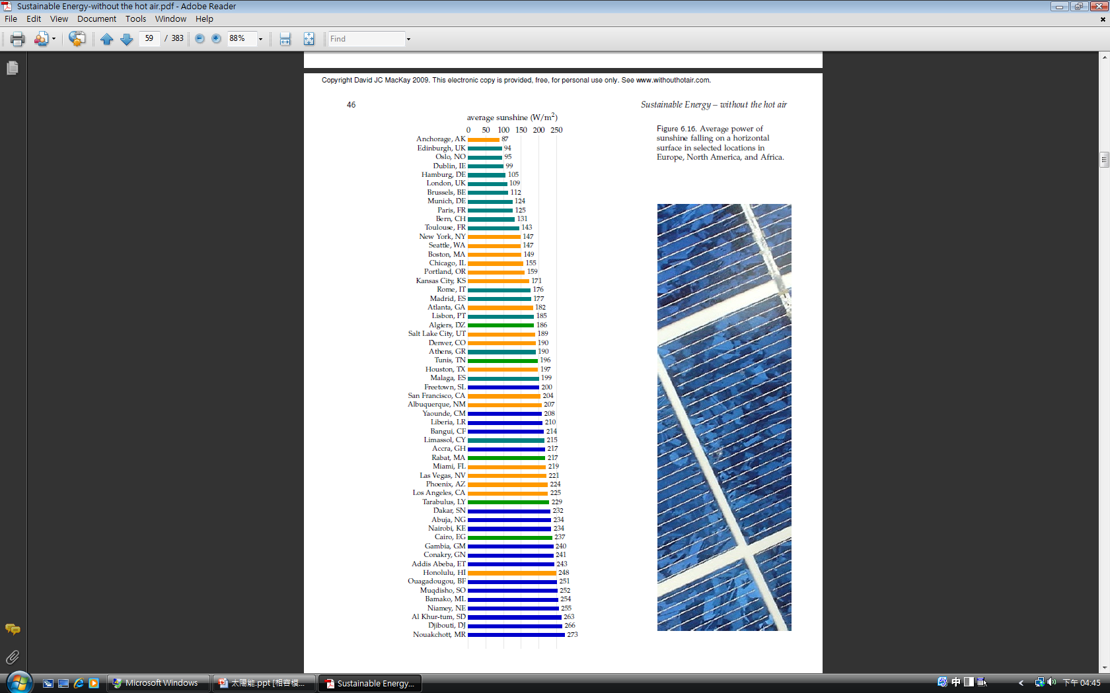
Taiwan has bright sunshine, particularly in Summer
Taiwan’s Average Sunshine：167 W/m²
Taiwan’s Average Electric Power：
167 W/m² × 24 h/d ＝ 4.0 kWh/m² d
167 W/m² × 24 h/d × 365 d/y ＝1,463 kWh/m² y
Source: David McKay, 2008, Cambridge University

Slide 15
Thank you for your attention ! Falin Chen National Taiwan University

